Slide 1
Christmas Camps with Elite Anglo-Chinese 2021
Zoom meeting, 5th December 2021
Mr D XU

Slide 2
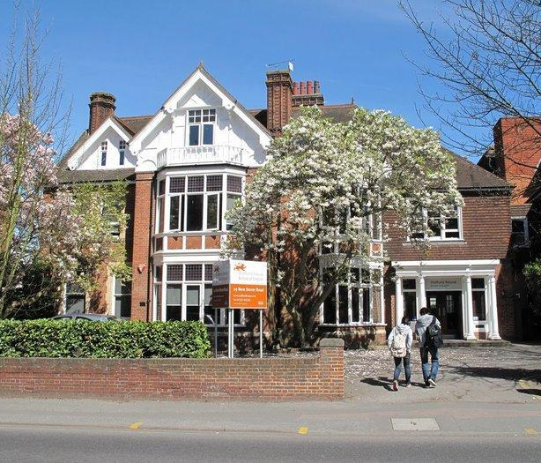
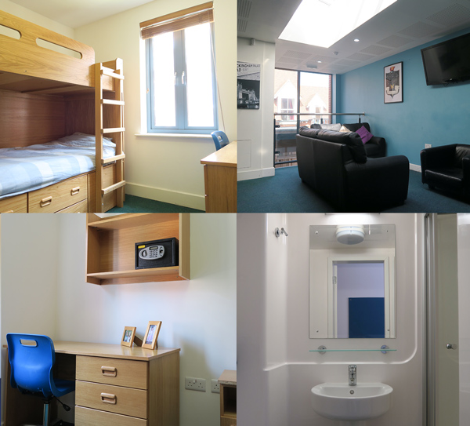
Stafford House
Stafford House camp location
A 10-minute walk from the city center
Traditional English house with garden
Easy access to supermarkets and excursions
Accommodation
Single rooms for everyone
Linen included
1 bedding change/ week
Bins emptied everyday and cleaned once a week
Recommend to bring own towels
Facilities
Classrooms, dining rooms, activity rooms and outdoor garden
Kitchen and laundry room inside the house
Designated canteen provides 3 meals with hot food
High speed wifi

Slide 3
Activities

Slide 4
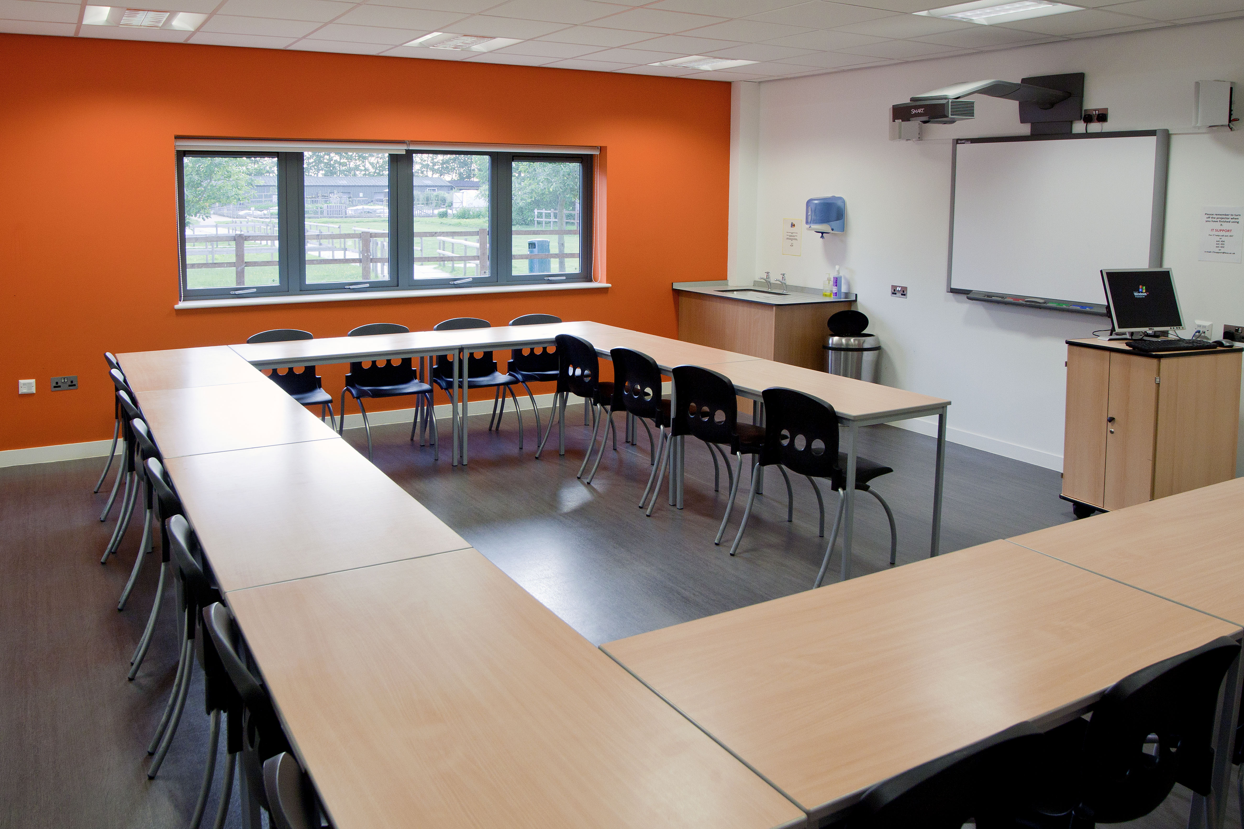
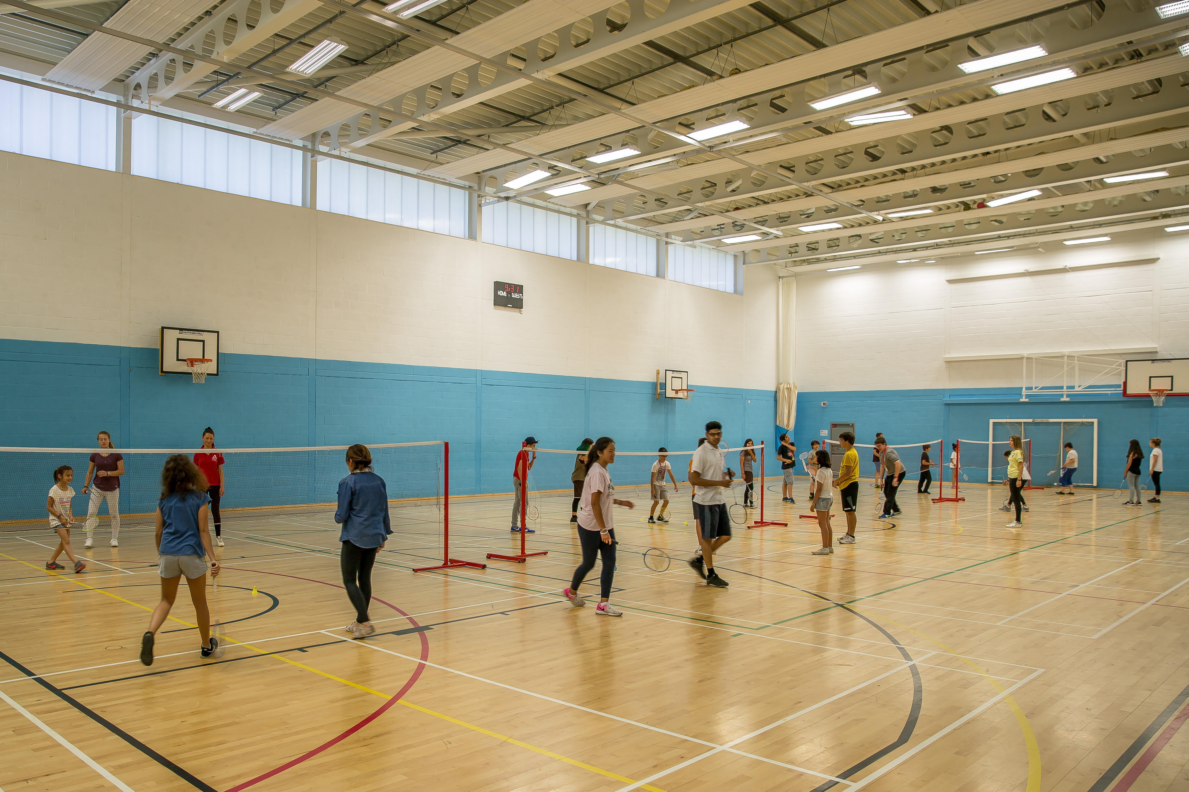
Berkshire College
Berkshire College camp location
In Maidenhead, 1h30 from London
Surrounded by playing fields and landscaped areas
Accommodation
Twin and single rooms
Linen included
1 bedding change/ week
Bins emptied everyday and cleaned once a week
Recommend to bring own towels
Facilities
Classrooms, meeting rooms, sports hall, large dining rooms etc
Catering hot meals for lunch and dinner, breakfast include pastries, fruits yoghurt etc
Wifi throughout college

Slide 5
Activities

Slide 6
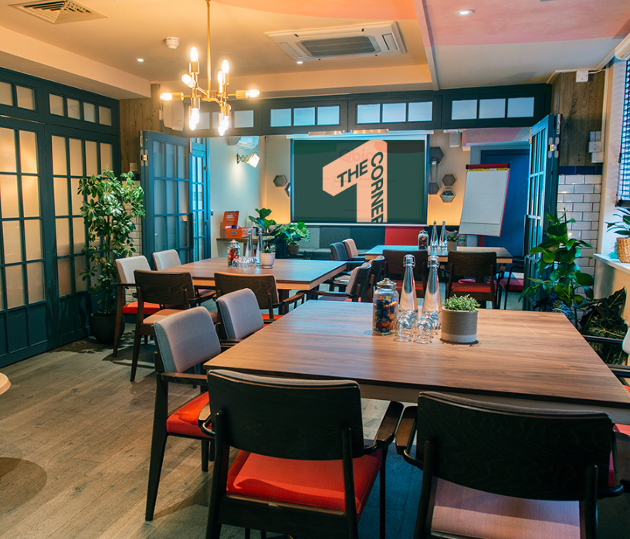
London Corner Hotel
London Corner Hotel
Located in central London next to Aldgate East station
Easy access to all the train stations
Accommodation
Big rooms with bathroom
Working desk in each room
Bin emptied each day and cleaned once a week
Provides towels
Facilities
Spacious common area for study and relax
Hot water station on each floor
Wifi fully covered
Laundry service is available when required

Slide 7
Before arrival
Talk to school and relevant Elite staff for detailed transport plans
Prepare suitcase and other belongings (Railcards, towels, winterwear, face masks, covid test kits, medication, pocket money etc, ID not needed)
On the day of travel
Charge your mobile before departure
Keep your mobile on all the time and update your whereabouts and time of arrival
Make a note of the mobile number of the Elite staff
In case of delay communication
On arrival a quick message to parents

Slide 8
Code of conduct
BEHAVIOUR
TOLERANCE
RESPECT
SAFETY
HEALTH
ENGLISH
TIME
COMMUNICATION

Slide 9
Code of conduct
SMOKING
DRUGS AND ALCOHOL
NIGHTTIME
STAY LEGAL
INTERNET USE
PRIVACY
GOING OUT*

Slide 10
Going out/ Absence from activities
Going out locally within 1 hour no permission from parents needed
If going out for the whole day or involves overnight, parents permission required (24 hours ahead)
Need parent’s permission if not attend activities
London Hotel – parents approval if comes back after 10pm

Slide 11
Covid testing
Same as in school (twice lateral flow tests per week)
If lateral flow test is positive, a PCR test will be booked at once
If confirmed positive self-isolation will happen
Once tested negative will continue to attend all activities

Slide 12
Emergencies
24-hour emergency contact phone number for each student
Onsite manager’s contact
Elite’s staff contact
Health assistance available onsite
Will be taken to see doctor or hospital if needs be

Slide 13
What do we need from parents
Parental consent form
Communicate with Elite on any allergies and health concern
Permission for your children to leave camp if needed

Slide 14
Q & A

